Slide 1

Notes:
Go full screen please: slides have lots of animations ☺
Do not hesitate to contact me:
sebastien.hillaire@frostbite.com
https://twitter.com/SebHillaire

Slide 2
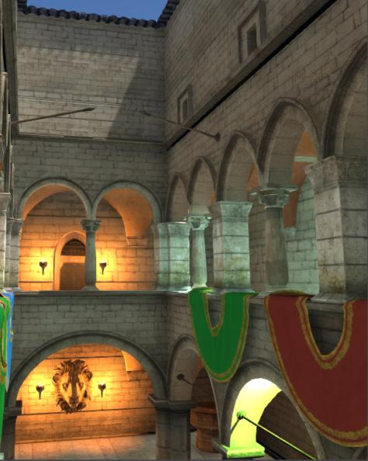
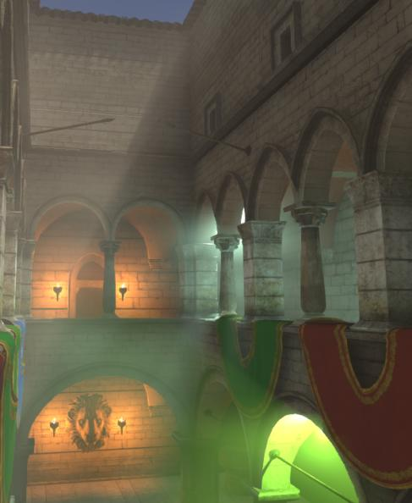

Physically Based and Unified Volumetric Rendering in Frostbite
Sebastien Hillaire - Electronic Arts / frostbite
Notes:
Hi and welcome to this course.
I am Sebastien Hillaire and I will present to you our recent work on Physically Based and Unified Volumetric Rendering in Frostbite.

Slide 3
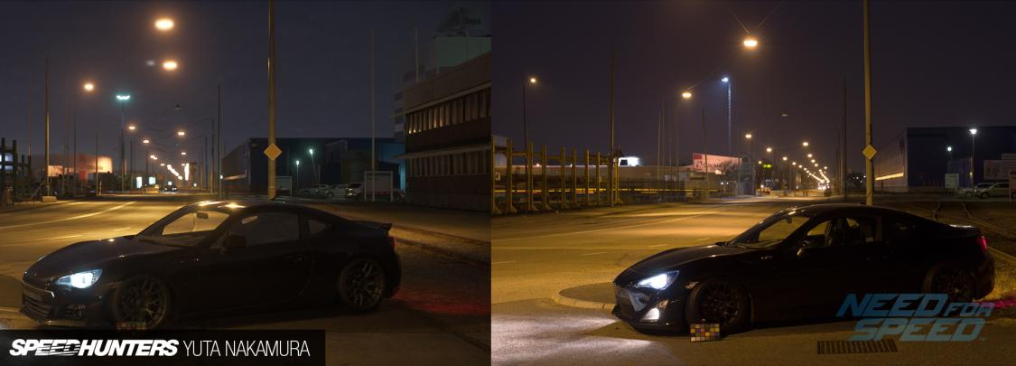
Context
Physically based rendering in Frostbite
See [Lagarde & de Rousiers 2014]
Huge increase in visual quality
Notes:
But first a bit of context.
We recently have moved Frostbite to be a physically based rendering engine. This resulted in a huge raise in quality as you can see in this NFS picture. It is hard to tell which one is from Frostbite or and which one is real.

Slide 4
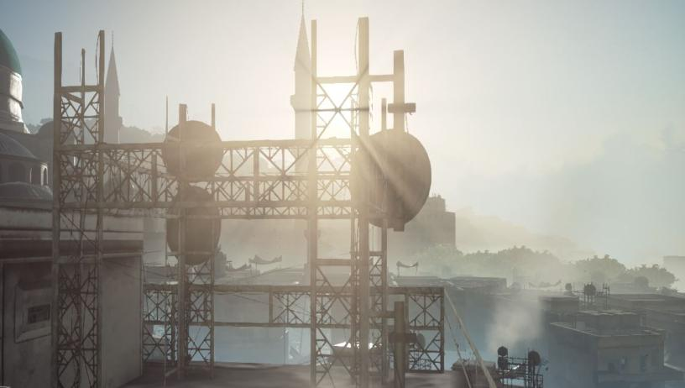
Context
Volumetric rendering in Frostbite was limited
Global distance/height fog
Screen space light shafts
Particles
Notes:
Despite all that, our volumetric rendering tech was still restricted to basic fog, screen space light shafts and particles. Nothing wrong with these techniques but we wanted more.

Slide 5
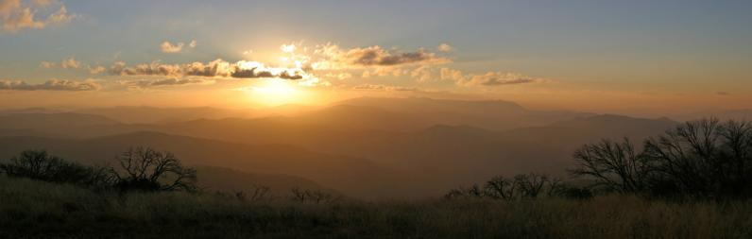
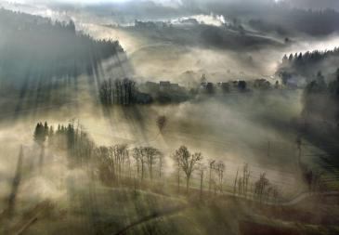
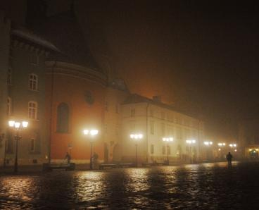
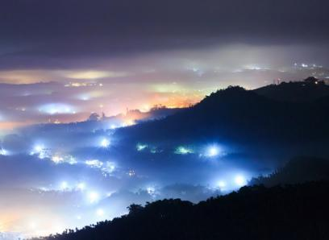
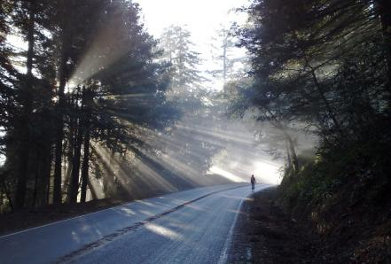
Real-life volumetric
Atmosphere and clouds
Varying density
Scattering events
More fog
Scattering occlusion
Notes:
We would like sky and atmosphere simulation, large scale fog, heterogeneous participating media, light scattering in the air and also the possibility to have occluded scattering resulting in volumetric shadows and light shafts.

Slide 6
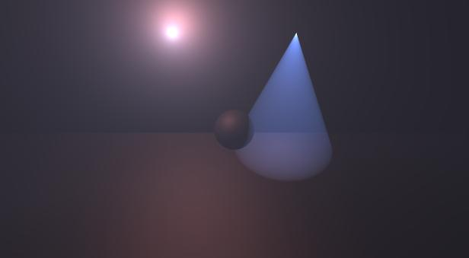
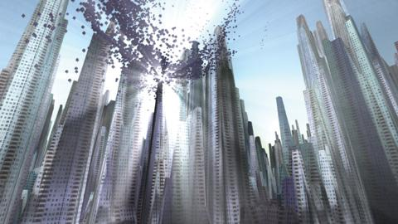
Previous work
Billboards
Analytic fog [Wenzel07]
Analytic light scattering [Miles]
Light shaft
Post process [Mitchell07]
Epipolar sampling [Engelhardt10]
[Miles]
[Mitchell07]
Notes:
Analytic fog / light scattering
Fast!
Not shadowed
Only homogeneous media
Screen space light shaft
High quality
Sun/sky needs to be visible on screen
Only homogeneous media
Can go for Epipolar sampling but this won’t save the day

Slide 7
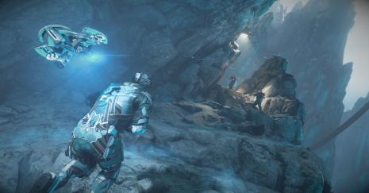
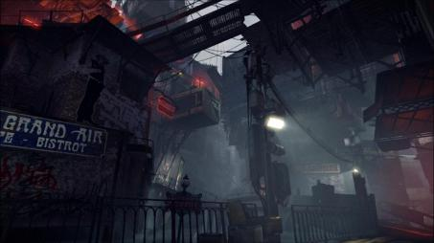
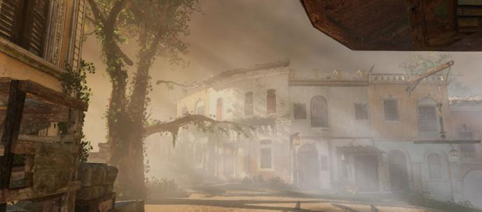
Previous work
[Valliant14]
Splatting
Light volumes
[Valliant14][Glatzel14][Hillaire14]
Emissive volumes [Lagarde13]
Volumetric fog [Wronski14]
Sun and local lights
Heterogeneous media
[Lagarde13]
Notes:
Splatting methods appeared largely with this new generation of consoles such as light volume splatting. This can result in high quality scattering but usually it does not match the participating media of the scene.
More recently Wronski presented a technique called Volumetric Fog, allowing spatially varying participating media and local lights to scatter. We were happy to see this as it was aligned with what we were doing at the time as you will see during this presentation. However it did not seem really physically based at the time and some features we wanted were missing.

Slide 8
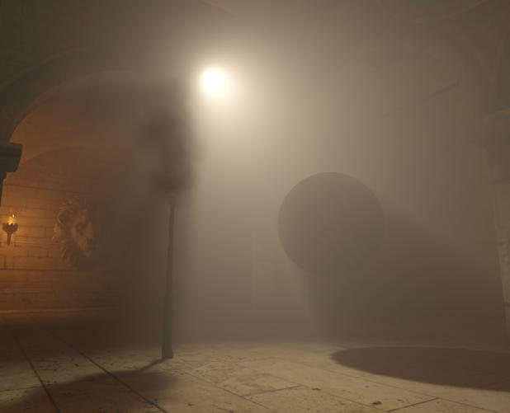
Scope and motivation
Increase visual quality and give more freedom to art direction!
Physically based volumetric rendering
Meaningful material parameters
Decouple material from lighting
Coherent results
Unified volumetric interactions
Lighting + regular and volumetric shadows
Interaction with opaque, transparent and particles
Notes:
Getting volumetric rendering will allow an increase in visual complexity and will result in more varied visuals and art directions.
We want it to be physically based: this means that participating media materials are decoupled from the light sources (e.g. no scattering colour on the light entities). Media parameters are also a meaningful set of parameters. With this we should get more coherent results that are easier to control and understand.
Also, because there are several entities interacting with volumetric in Frostbite (fog, particles, opaque&transparent surfaces, etc). We also want to unify the way we deal with that to not have X methods for X types of interaction.

Slide 9
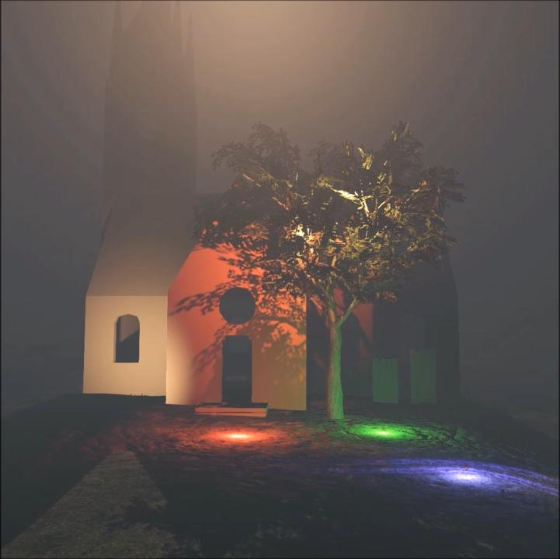
Results
Notes:
This video gives you an overview of what we got from this work: lights that generate scattering according to the participating media, volumetric shadow, local fog volumes, etc.
And I will show you now how we achieve it.

Slide 10
Outline
Volumetric rendering
Volumetric shadows
More volumetric rendering in Frostbite
Conclusion

Slide 11
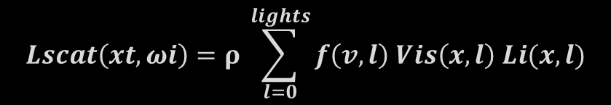
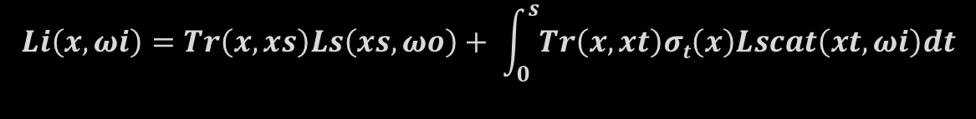
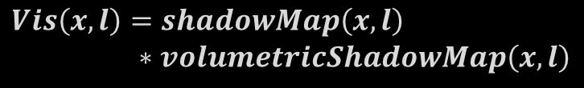


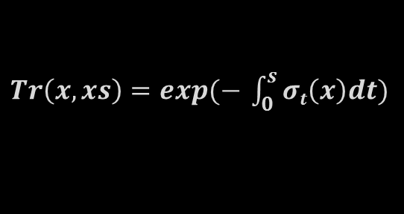
Volumetric rendering: single scattering
$$x$$
$$xs$$
$$Li\left(x,ωi\right)=Tr\left(x,xs\right)Ls\left(xs,ωo\right)+ \int_{0}^{s}{Tr\left(x,xt\right)σt\left(x\right)Lscat\left(xt,ωi\right)dt}$$
$Tr\left(x,xs\right)=exp(− \int_{0}^{s}{σt\left(x\right)dt})$
$$Lscat\left(xt,ωi\right)=ρ \sum_{l=0}^{lights}{f\left(v,l\right) Vis\left(x,l\right) Li(x,l)}$$
$$Vis\left(x,l\right)=shadowMap\left(x,l\right)$$
$$∗volumetricShadowMap\left(x,l\right)$$
Notes:
As of today we restrict ourselves to single scattering when rendering volumetric. This is already challenging to get right.
When a light surface interact with a surface, it is possible to evaluate the amount of light bounce to the camera by evaluating for example a BRDF. But in the presence of participating media, things get more complex.
You have to take into account transmittance when the light is traveling through the media
Then you need to integrate the scattered light along the view ray by taking many samples
For each of these samples, you also need to take into account transmittance to the view point
You also need to integrate the scattered light at each position
And take into account phase function, regular shadow map (opaque objects) and volumetric shadow map (participating media and other volumetric entity)

Slide 12
Our approach: clip space volumes
Frustum aligned 3D textures [Wronski14]
Frustum voxel in world space => Froxel ☺
Note: Frostbite is a tiled-based deferred lighting
16x16 tiles with culled light lists
Align volume tiles on light tiles
Reuse per tile culled light list
Volume tiles can be smaller (8x8, 4x4, etc.)
Careful correction for resolution integer division
Default: 8x8 volume tiles, 64 Depth slices
Depth
Screen Y
Screen X
Notes:
As in Wronski, All our volumes are 3d textures that are clip space aligned (such voxels become Froxels in world space, Credit Alex Evans and Sony ATG ☺, see Learning from Failure: a Survey of Promising, Unconventional and Mostly Abandoned Renderers for ‘Dreams PS4’, a Geometrically Dense, Painterly UGC Game’, Advances in Real-Time Rendering course, SIGGRAPH 2015).
This volume is also aligned with our screen light tiles. This is because we are reusing the forward light tile list culling result to accelerate the scattered light evaluation (remember, Frostbite is a tile based deferred lighting engine).
Our volume tiles in screen space can be smaller than the light tiles (which are 16x16 pixels).
By default we use
Depth resolution of 64
8x8 volume tiles
720p requires 160x90x64 (~7mb per rgbaF16 texture)
1080p requires 240x135x64 (~15mb per rgbaF16 texture)

Slide 13
Our approach: data flow
Participating media entities
Lighting and shadowing information
Input data
Clip space volumes
1. Material properties
2. Froxel Light Scattering
3. Final integration
Notes:
This is an overview of our data flow.
We are using clip space volumes to store the data at different stages of our pipeline.
We have material properties which are first voxelised from participating media entities.
Then using light sources of our scene and this material property volume we can generate scattered light data per froxel. This data can be temporally upsampled to increase the quality. Finally, we have an integration step that prepares the data for rendering.

Slide 14
Our approach: data flow
Participating media entities
Lighting and shadowing information
Input data
Clip space volumes
1. Material properties
2. Froxel Light Scattering
3. Final integration

Slide 15
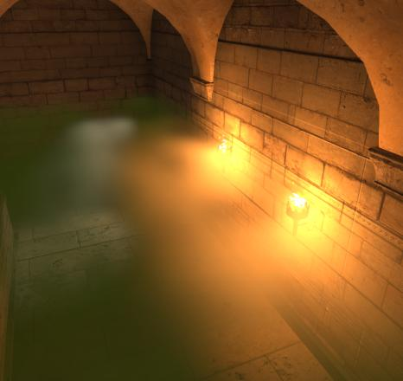
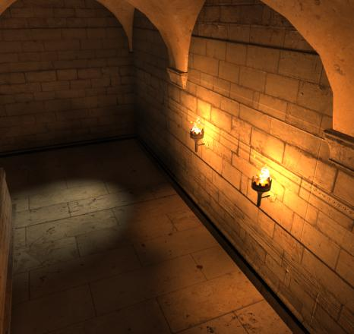
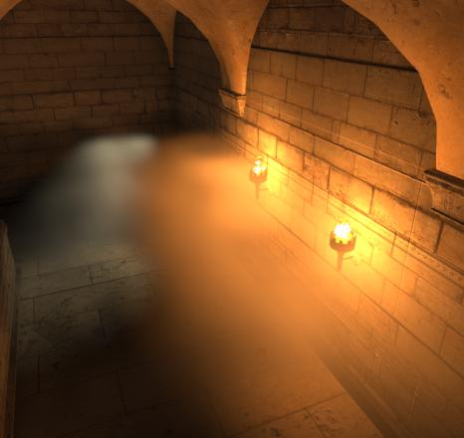
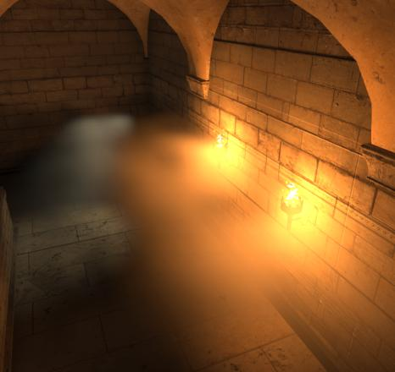
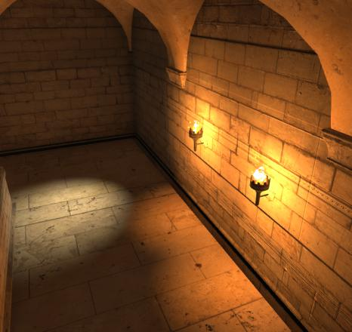
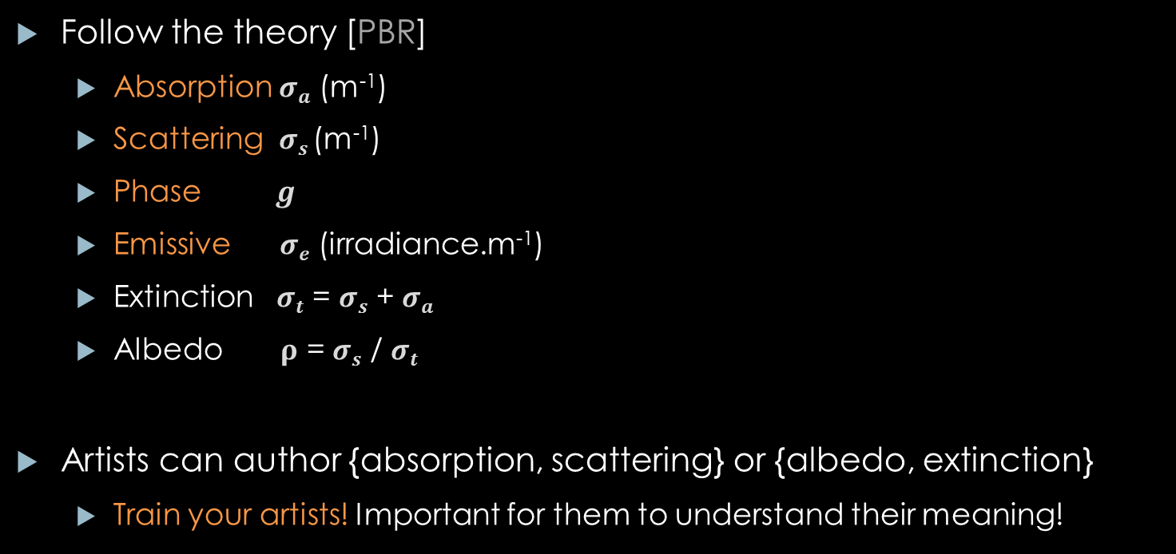
Participating media material definition
Follow the theory [PBR]
Absorption $σa$ (m⁻¹)
Scattering $σs$(m⁻¹)
Phase $g$
Emissive $σe$ (irradiance.m⁻¹)
Extinction $σt$ = $σs$ + $σa$
Albedo $ρ$ = $σs$ / $σt$
Artists can author {absorption, scattering} or {albedo, extinction}
Train your artists! Important for them to understand their meaning!
Notes:
Our participating medias are defined according to the state of the art in physically based rendering.
We have the following list of properties:
- Absorption describing the amount of light absorbed by the media over a certain path length
- Scattering describing the amount of light scattered over a certain path length
- Emissive describing emitted light
- And a single lobe phase function describing how the light bounces on particles (uniformly, forward scattering, etc.). It is based on Henyey-Greenstein (and you can use the Schlick approximation).
As with every physically based component, it is very important for artists to understand them so take the time to educate them.

Slide 16
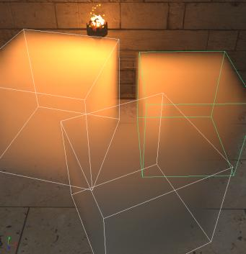
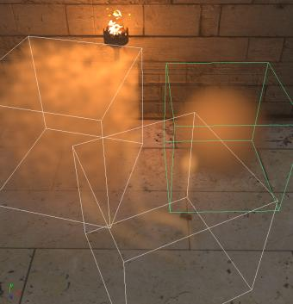
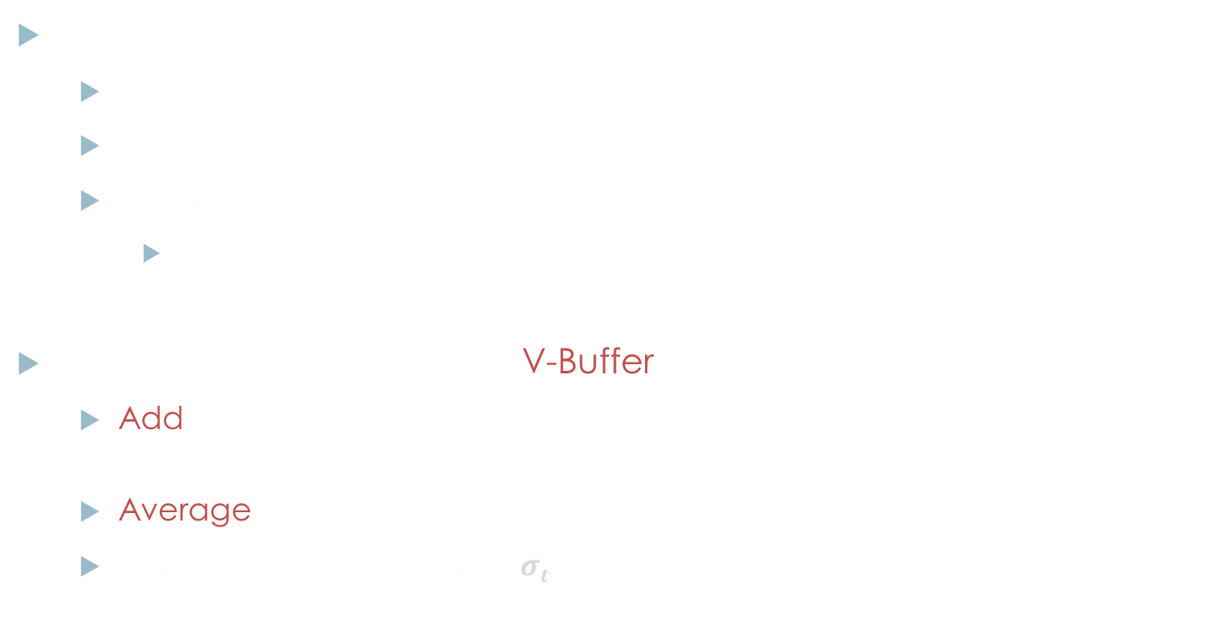
Participating Media (PM) properties voxelization
PM sources
Depth fog
Height fog
Local fog volumes
With or W/o density textures
Voxelize PM properties into V-Buffer
Add Scattering, Emissive and Extinction
Average Phase g (no multi lobe)
Wavelength independent $σt$ (for now)
Without density textures
With density textures
V-Buffer (per Froxel data) |  |  |  | Format
Scattering R | Scattering G | Scattering B | Extinction | RGBA16F
Emissive R | Emissive G | Emissive B | Phase (g) | RGBA16F
Notes:
Depth/height fog and local fog volumes are entities that can be voxelized. You can see here local fog volumes as plain or with varying density according to a density texture.
We voxelize them into a Vbuffer analogous to screen Gbuffer but in Volume (clip space). We basically add all the material parameters together since they are linear. Except the phase function which is averaged. We only also only consider a single lobe for now according to the HG phase function.
We have deliberately chosen to go with wavelength independent extinction to have cheaper volumes (material, lighting, shadows). But it would be very easy to extend if necessary at some point.
Supporting emissive is an advantage for artist to position local fog volume that emit light as scattering would do but that do not match local light. This can be used for cheap ambient lighting.

Slide 17
Our approach: data flow
Participating media entities
Lighting and shadowing information
Input data
Clip space volumes
1. Material properties
2. Froxel Light Scattering
3. Final integration

Slide 18
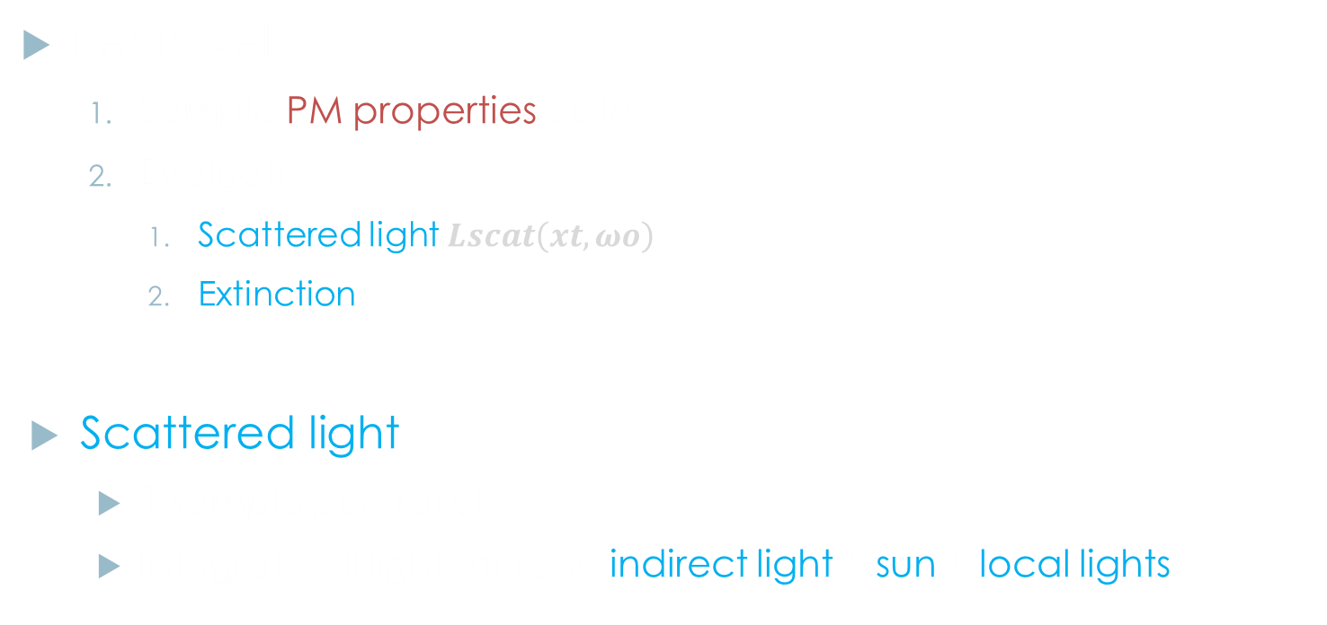
Froxel integration
Per froxel
Sample PM properties data
Evaluate
Scattered light $Lscat\left(xt,ωo\right)$
Extinction
Scattered light:
1 sample per froxel
Integrate all light sources: indirect light + sun + local lights
Scattering/Transmittance Buffer |  |  |  | Format
 |  |  | Extinction | RGBA16F
Scattered light to camera RGB
Notes:
For each froxel, one thread will be in charge of gathering scattered light and extinction.
Extinction is simply copied over from the material. You will see later why this is important for visual quality in the final stage (to use extinction instead of transmittance for energy conservative scattering). Extinction is also linear so it will be better to temporally integrate it instead of the non linear transmittance value.

Slide 19
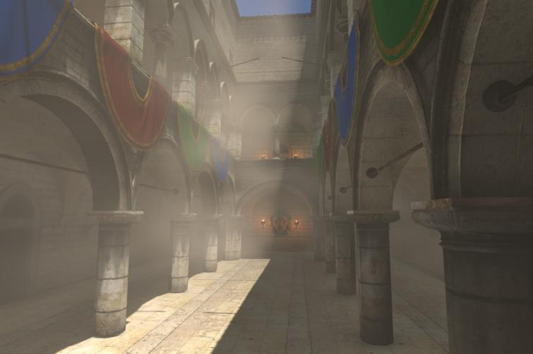
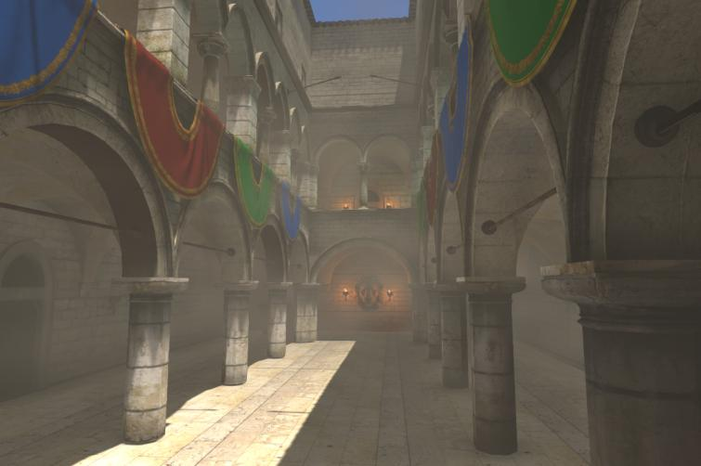
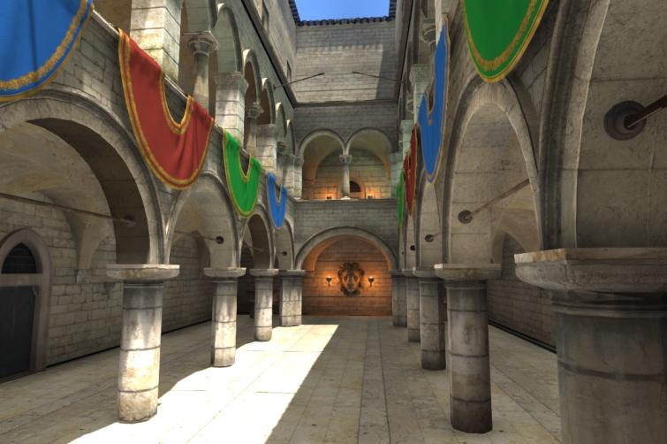
Froxel integration: Sun/Ambient/Emissive
Indirect light on local fog volume
From Frostbite diffuse SH light probe
1 probe at volume centre
Integrate w.r.t. phase function as a SH cosine lobe [Wronski14]
Sun light
Sample cascaded shadow maps
Notes:
Then we integrate the scattered light. One sample per froxel.
We first integrate ambient the same way as Wronski. Frostbite allows us to sample diffuse SH light probes. We use one per local fog volume positioned at their centre.
We also integrate the sun light according to our cascaded shadow maps. We could use exponential shadow maps but we do not as our temporal up-sampling is enough to soften the result.
You can easily notice the heterogeneous nature of the local fog shown here.

Slide 20
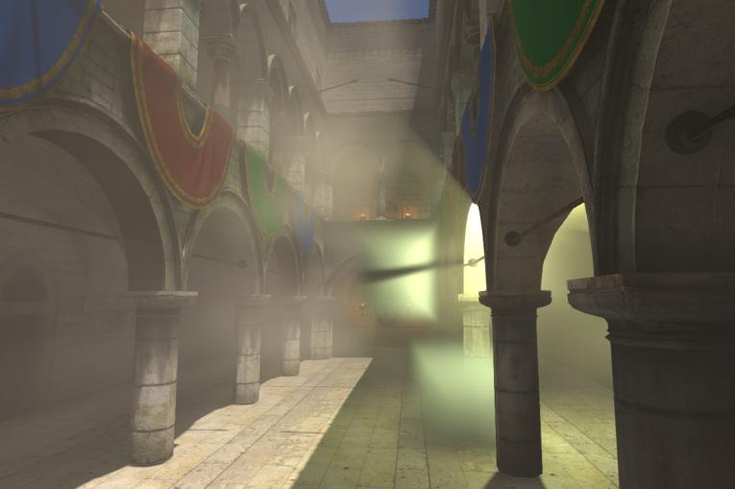
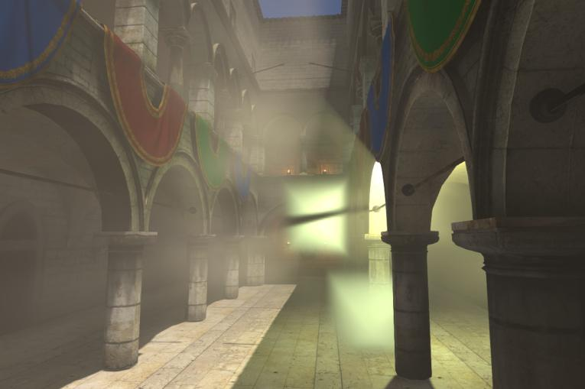
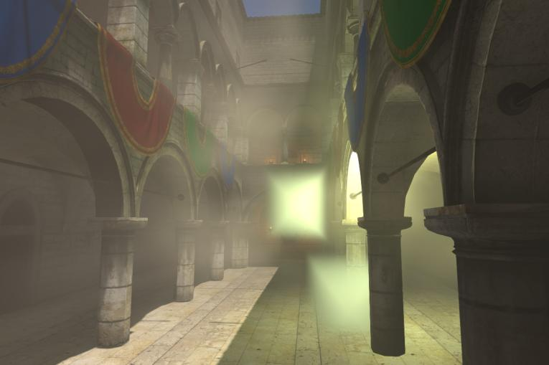
Froxel integration: Local lights
Local lights
Reuse tiled-lighting code
Use forward tile light list post-culling
No scattering? skip local lights
Shadows
Regular shadow maps
Volumetric shadow maps
Notes:
We also integrate local lights. And we re-use the tile culling result to only take into account lights visible within each tile.
One good optimisation is to skip it all if you do not have any scattering possible according to your material properties.
Each of these lights can also sample their associated shadow maps. We support regular shadow maps and also volumetric shadow maps (described later).

Slide 21
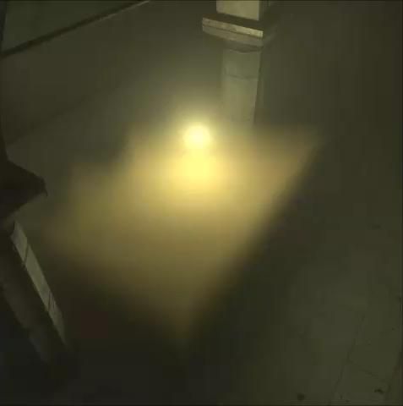
Temporal volumetric integration
1 scattering/extinction sample per frame
Under sampling with very strong material
Aliasing under camera motion
Shadows make it worse
Notes:
As I said, we are only using a single sample per froxel.
This can unfortunately result in very strong aliasing for very thick participating media and when integrating the local light contribution.

Slide 22
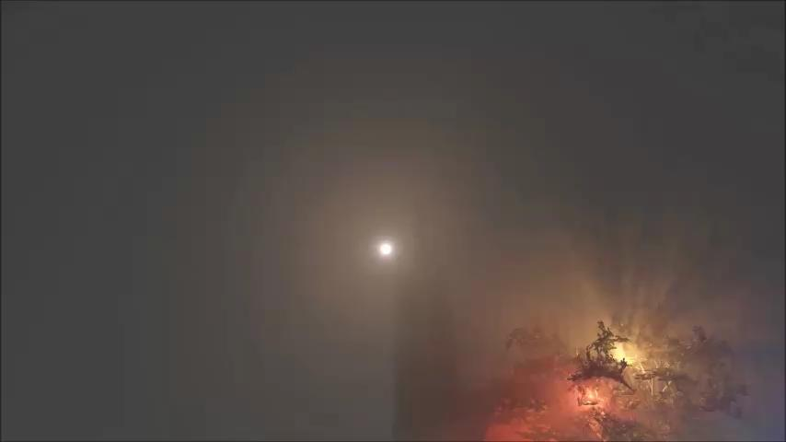
Temporal volumetric integration
Notes:
You can also notice it in the video, as well as very strong aliasing of the shadow coming from the tree.

Slide 23
Temporal volumetric integration
Solution: Temporal integration
Jittered samples (Halton)
Same offset for all samples along view ray
Jitter scattering AND material samples in sync
Re-project previous scattering/extinction
5% Blend current with previous
Exponential moving average [Karis14]
Out of Frustum: skip history
Frame N-1
Frame N
Notes:
To mitigate these issues, we temporally integrate our frame result with the one of previous frame. (well know, also used by Karis last year for TAA).
To achieve this,
we jitter our samples per frame uniformly along the view ray
The material and scattered light samples are jittered using the same offset (to soften evaluated material and scattered light)
Integrate each frame according to an exponential moving average
And we ignore previous result in case no history sample is available (out of previous frustum)

Slide 24
With Temporal volumetric integration
Notes:
This video shows the before after result of the temporal integration.

Slide 25
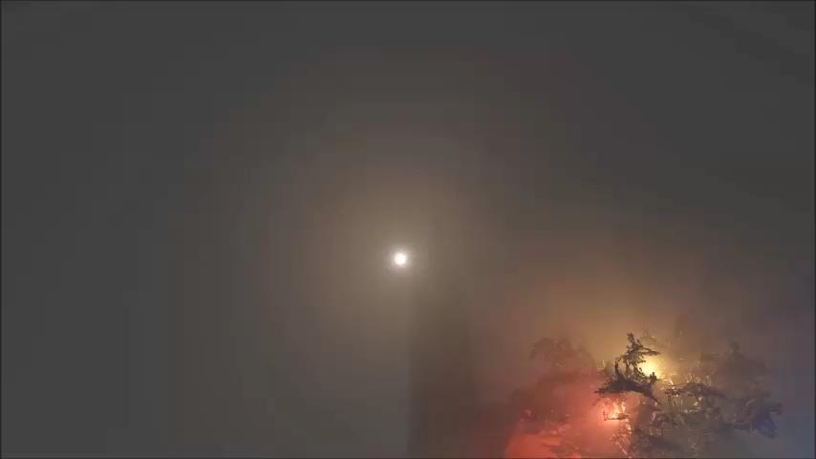
With Temporal volumetric integration
Notes:
This video shows how the aliasing of the local light shadow is removed and result in a softer look.

Slide 26
Temporal volumetric integration
Remaining issues
Material animation leaves trails
Re-project using velocity?
What about multiple volumes intersecting?
What about animated volumes? (e.g. fluid simulation)
Moving lights leave trails
Use neighbour clamping? [Karis14]
Challenging R&D area!
Notes:
This is great and promising but there are several issues remaining:
Local fog volume and lights will leave trails when moving
One could use local fog volumes motion stored in a buffer the same way as we do in screenspace for motion blur
But what do we do when two volumes intersect? This is the same problem as deep compositing
For lighting, we could use neighbour colour clamping but this will not solve the problem entirely
This is an exciting and challenging R&D area for the future and I’ll be happy to discuss about it with you if you have some ideas ☺

Slide 27
Our approach: data flow
Participating media entities
Lighting and shadowing information
Input data
Clip space volumes
1. Material properties
2. Froxel Light Scattering
3. Final integration

Slide 28
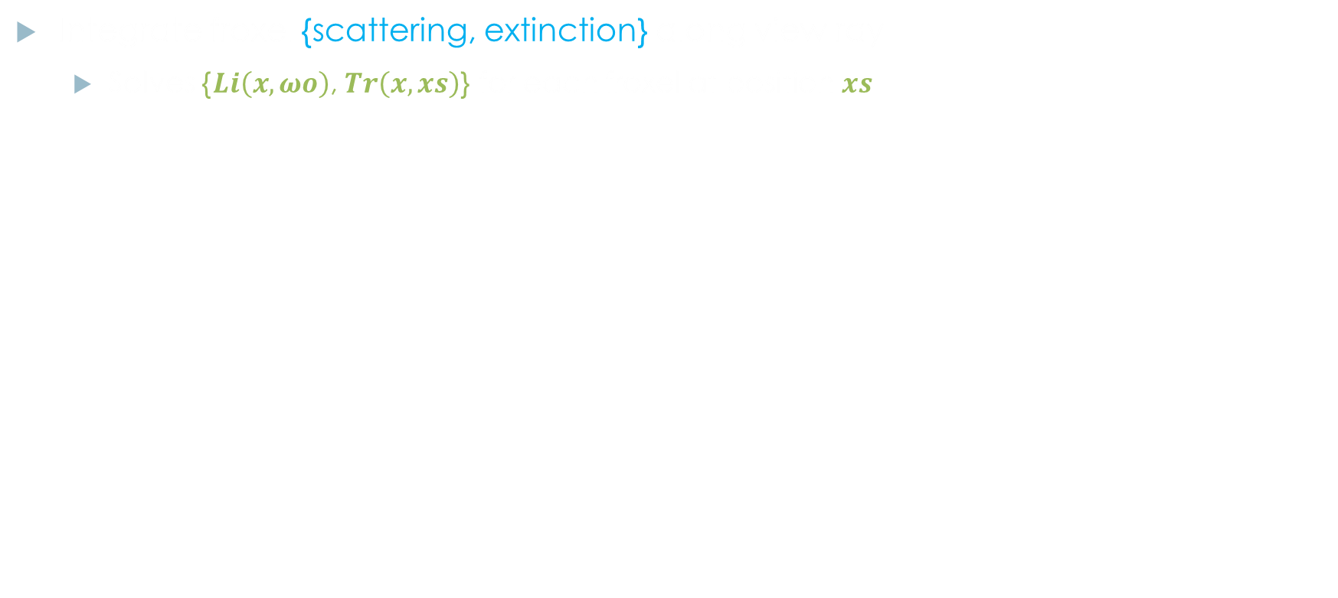
Final PM volume
Integrate froxel {scattering, extinction} along view ray
Solves {$Li\left(x,ωo\right)$, $Tr\left(x,xs\right)$} for each froxel at position$xs$
float4 accumScatteringTransmittance = float4(0.0, 0.0, 0.0, 1.0);
for (uint textureDepth = 0; textureDepth < volumeDepth; ++textureDepth)
{
uint4 coord = uint4(DispatchThreadId.xy, textureDepth,0);
float4 scatteringExtinction = g_ ScatteringExtinctionVolume.Load(coord);
const float transmittance = exp(-scatteringExtinction.a*stepLen);
accumScatteringTransmittance.rgb += scatteringExtinction.rgb*accumScatteringTransmittance.a;
accumScatteringTransmittance.a *= transmittance;
g_FinalScatteringTransmittanceVolumeOut[coord.xyz] = accumScatteringTransmittance;
}
Wrong
Notes:
We basically accumulate near to far scattering according to transmittance. This will solve the integrated scattered light and transmittance along the view and that for each froxel.
One could use the code sample shown here: accumulate scattering and then transmittance for the next froxel, and this slice by slice. However, that is completely wrong. Indeed there is a dependency on the accumScatteringTransmitance.a value (transmittance). Should we update transmittance of scattering first?

Slide 29
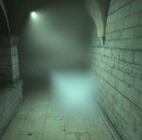
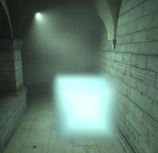
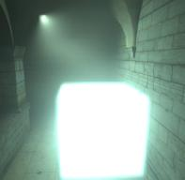
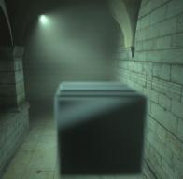
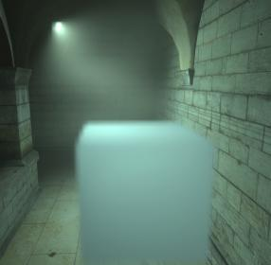

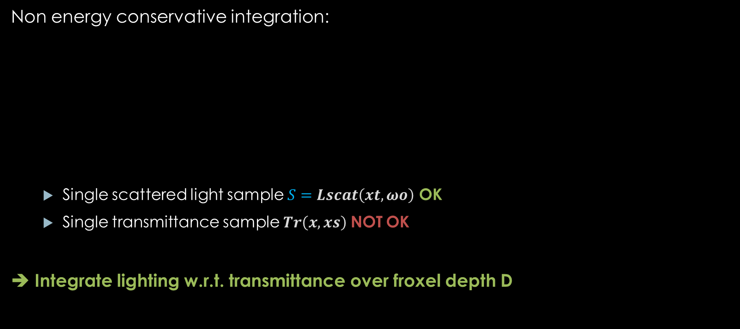

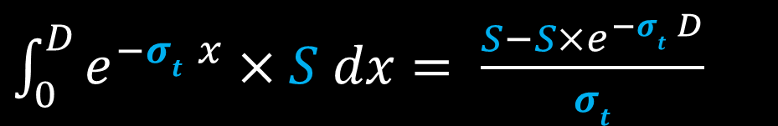



Final PM volume
swapped scattering/transmittance
code
Non energy conservative integration:
Single scattered light sample $S=Lscat\left(xt,ωo\right)$ OK
Single transmittance sample $Tr\left(x,xs\right)$ NOT OK
➔ Integrate lighting w.r.t. transmittance over froxel depth D
$σs$= 5
$σs$= 50
$σs$= 5000
$σs$= 5000
$σs$= 5000
$\int_{0}^{D}{e^{−σt x}}×S dx= \frac{S−S×e^{−σt D}}{σt}$
Notes:
You can see here multiple volumes with increasing scattering properties. It is easy to understand that integrating scattering and then transmittance is not energy conservative.
We could reverse the order of operations. You can see that we get somewhat get back the correct albedo one would expect but it is overall too dark and temporally integrating that is definitely not helping here.
So how to improve this? We know we have one light and one extinction sample.
We can keep the light sample: it is expensive to evaluate and good enough to assume it constant on along the view ray inside each depth slice.
But the single transmittance is completely wrong. The transmittance should in fact be 0 at the near interface of the depth layer and exp(-mu_t d) at the far interface of the depth slice of width d.
What we do to solve this is integrate scattered light analytically according to the transmittance in each point on the view ray range within the slice. One can easily find that the analytical integration of constant scattered light over a definite range according to one extinction sample can be reduced this equation.
Using this, we finally get consistent lighting result for scattering and this with respect to our single extinction sample (as you can see on the bottom picture).

Slide 30
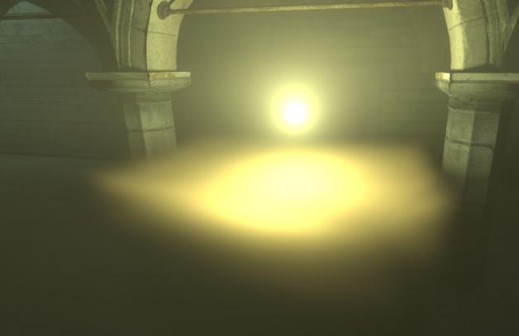
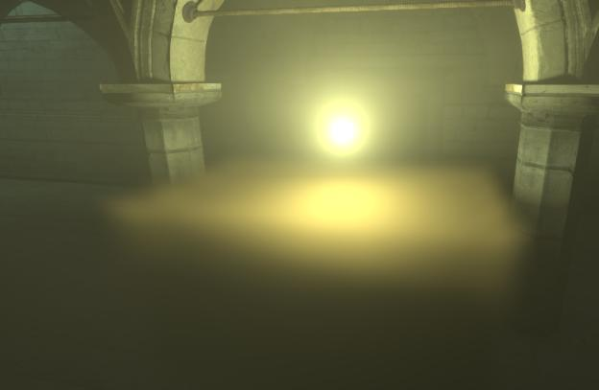
Final PM volume
Also improves with volumetric shadows
Without fixed integration: light leaking
With improved integration:
Notes:
You can also see that this fixes the light leaking we noticed sometimes for relatively large depth slices and strongly scattering media even when volumetric shadow are enabled.

Slide 31
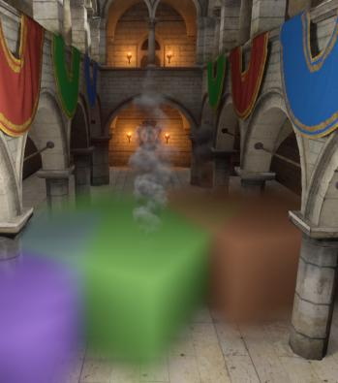


Final PM volume rendering on scene
{$Li\left(x,ωo\right)$, $Tr\left(x,xs\right)$} Similar to pre-multiplied color/alpha
Applied on opaque surfaces per pixel
Evaluated on transparent surfaces per vertex, applied per pixel
Camera
view point
New view with locked PM volumes
Notes:
Once we have that final integrated buffer, we can apply it on everything in our scene during the sky rendering pass. As it contains scattered light reaching the camera and transmittance, it is easy to apply it as a pre-multiplied colour-alpha on everything.
For efficiency, it is applied per vertex on transparents but we are thinking of switching this to per pixel for better quality.

Slide 32
Result validation
Compare results to references from Mitsuba
Physically based path tracer
Same conditions: single scattering only, exposure, etc.
Scene 1:
Notes:
Our target is to get physically based results. As such, we have compared our results against the physically based path tracer called Mitsuba. We constrained Mitsuba to single scattering and to use the same exposure, etc. as our example scenes.
The first scene I am going to show you is a thick participating media layer with a light above and then into it.

Slide 33








Result validation - scene 1
Render (light above)
Luminance gradient
Render (light inside)
Luminance gradient
Frostbite
Mitsuba
Notes:
You can see here the frostbite render on top and Mitsuba render at the bottom. You can also see the scene with a gradient applied to it. It is easy to see that our result matches, you can also recognize the triangle shape of scattered light when the point lights is within the medium.
This is a difficult case when participating media is non uniform and thick due to our discretisation of volumetric shadows and material representation. So you can see some small differences. But overall, it matches and we are happy with these first results and improve them in the future.

Slide 34








Result validation - scene 2
Render
Luminance gradient
Render
Luminance gradient
Frostbite
G=0
G=0.9
Mitsuba
Notes:
This is another example showing very good match for an HG phase function with g=0 and g=0,9 (strong forward scattering).

Slide 35

Performance
Sun + shadow cascade
14 point lights
2 with regular & volumetric shadows
6 local fog volumes
All with density textures
Notes:
I am now going to give the performance we obtain for the following scene.

Slide 36
Performance: PS4, 900p
Volume tile resolution | 8x8 | 16x16
PM Material voxelization | 0.45 ms | 0.15 ms
Light scattering | 2.00 ms | 0.50 ms
Final accumulation | 0.40 ms | 0.08 ms
Application (Fog pass) | +0.1 ms | +0.1 ms
Total | 2.95 ms | 0.83 ms
64 depth slices
Plan for your use cases
High or low frequency media? Local lights needed? Emissive needed? Etc.
Light scattering components | 8x8
Local lights | 1.1 ms
+Sun scattering | +0.5 ms
+Temporal integration | +0.4 ms
Notes:
You can see that the performance varies a lot depending on what you have enabled and the resolution of the clip space volumes.
This shows that it will be important to carefully plan what are the needs of you game and different scenes. Maybe one could also bake static scenes scattering and use the emissive channel to represent the scattered light for an even faster rendering of complex volumetric lighting.

Slide 37
Outline
Volumetric rendering
Volumetric shadows
More volumetric rendering in Frostbite
Conclusion
Notes:
Now I want to describe how we can get our particles to cast volumetric shadows in Frostbite.

Slide 38

Volumetric shadow maps
Additional extinction volumes
3 levels clip-map oriented on frustum
Required for out-of-view shadow casters
Store extinction
Volumetric shadow maps
3d textures store transmittance
Ortho/perspective mapping for point/spot lights
Notes:
We also support volumetric shadow maps (shadow resulting from voxelized volumetric entities in our scene)
To this aim, we went for a simple and fast solution
We first define a 3 levels cascaded clip map volume following and containing the camera.
With tweakable per level voxel size and world space snapping
This volume contains all our participating media entities voxelized again within it (required for out of view shadow caster, clip space volume would not be enough)
A volumetric shadow map is defined as a 3D texture (assigned to a light) that stores transmittance
Transmittance is evaluated by ray marching the extinction volume
Projection is chosen as a best fit for the light type (e.g. frustum for spot light)
Our volumetric shadow maps are stored into an atlas to only have to bind a single texture (with uv scale and bias) when using them.

Slide 39

Volumetric shadow maps
Part of our common light shadow system
Opaque
Particles
Participating media
Notes:
Volumetric shadow maps are entirely part of our shared lighting pipeline and shader code.
It is sampled for each light having it enabled and applied on everything in the scene (particles, opaque surfaces, participating media) as visible on this video.

Slide 40



Particle volumetric shadows
trilinear
Sphere
Default
High quality option
Selectable per emitter
Notes:
Another bonus is that we also voxelize our particles.
We have tried many voxelization method. Point and its blurred version but this was just too noisy. Our default voxelization method is trilinear. You can see the shadow is very soft and there is no popping visible.
We also have a high quality voxelization where all threads write all the voxels contained within the particle sphere. A bit brute force for now but it works when needed.
You can see the result of volumetric shadows from particle onto participating media in the last video.
(See bonus slides for more details)

Slide 41
Performance: PS4
Ray marching of 32³ volumetric shadow maps
Spot light: 0.04 ms
Point light: 0.14 ms
1k particles voxelization
Default quality: 0.03 ms
High quality: 0.25 ms
Notes:
Some performance numbers.
Point lights are more expensive than spot lights because spot lights are integrated slice by slice whereas a full raytrace is done for each point light shadow voxels. We have ideas to fix that in the near future.
Default particle voxelization is definitely cheap for 1K particles.

Slide 42
Outline
Volumetric rendering
Particle volumetric shadows
More volumetric rendering in Frostbite
Conclusion
Notes:
If we have more time, let me describe the additional volumetric rendering goodies we have in Frostbite.

Slide 43





Particle/Sun interaction
High quality scattering and self-shadowing for sun/particles interactions
Fourier opacity Maps [Jansen10]
Used in production now
Notes:
Our translucent shadows in Frostbite (see Andersson11) allows particles to cast shadows on opaque surfaces but not on themselves. This technique also did not support scattering.
We have added that support in frostbite by using Fourier opacity mapping. This allows us to have some very high quality coloured shadowing, scattering resulting in sharp silver lining visual effects as you can see on this screenshots and cloud video.
This is one special case for the sun (non unified) but it was needed to get that extra bit of quality were needed for the special case of the sun which requires special attention.

Slide 44


Physically-based sky/atmosphere
Improved from [Elek09] (Simpler but faster than [Bruneton08])
Collaboration between Frostbite, Ghost and DICE teams.
In production: Mirror’s Edge Catalyst, Need for Speed and Mass Effect Andromeda
Mass Effect Andromeda, Bioware
Need for Speed, Ghost
Notes:
We also have added support for physically based sky and atmosphere scattering simulation last year. This was a fruitful collaboration between Frostbite and Ghost and DICE game teams (Mainly developed by Edvard Sandberg and Gustav Bodare at Ghost). Now it is used in production by lots games such as Mirror’s Edge or Mass Effect Andromeda.
It is an improved version of Elek’s paper which is simpler and faster than Bruneton. I unfortunately have no time to dive into details in this presentation.
But in the comment I have time ☺. Basically, the lighting artist would define the atmosphere properties and the light scattering and sky rendering will automatically adapt to the sun position. When the atmosphere is changed, we need to update our pre-computed lookup tables and this can be distributed over several frame to limit the evaluation impact on GPU.

Slide 45
Conclusion
Physically-based volumetric rendering framework
used for all games powered by Frostbite in the future
Physically based volumetric rendering
Participating media material definition
Lighting and shadowing interactions
A more unified volumetric rendering system
Handles many interactions
Participating media, volumetric shadows, particles, opaque surfaces, etc.

Slide 46
Future work
Improved participating media rendering
Phase function integral w.r.t. area lights solid angle
Inclusion in reflection views
Graph based material definition, GPU simulation, Streaming
Better temporal integration! Any ideas?
Sun volumetric shadow
Transparent shadows from transparent surfaces?
Optimisations
V-Buffer packing
Particles voxelization
Volumetric shadow maps generation
How to scale to 4k screens efficiently
Notes:
There is lots of room to improve this technology. You have some example here in no special order.

Slide 47
References
[Lagarde & de Rousiers 2014] Moving Frostbite to PBR, SIGGRAPH 2014.
[PBR] Physically Based Rendering book, http://www.pbrt.org/.
[Wenzel07] Real time atmospheric effects in game revisited, GDC 2007.
[Mitchell07] Volumetric Light Scattering as a Post-Process, GPU Gems 3, 2007.
[Andersson11] Shiny PC Graphics in Battlefield 3, GeForceLan, 2011.
[Engelhardt10] Epipolar Sampling for Shadows and Crepuscular Rays in Participating Media with Single Scattering, I3D 2010.
[Miles] Blog post http://blog.mmacklin.com/tag/fog-volumes/
[Valliant14] Volumetric Light Effects in Killzone Shadow Fall, SIGGRAPH 2014.
[Glatzel14] Volumetric Lighting for Many Lights in Lords of the Fallen, Digital Dragons 2014.
[Hillaire14] Volumetric lights demo
[Lagarde13] Lagarde and Harduin, The art and rendering of Remember Me, GDC 2013.
[Wronski14] Volumetric fog: unified compute shader based solution to atmospheric solution, SIGGRAPH 2014.
[Karis14] High Quality Temporal Super Sampling, SIGGRAPH 2014.
[Jansen10] Fourier Opacity Mapping, I3D 2010.
[Salvi10] Adaptive Volumetric Shadow Maps, ESR 2010.
[Elek09] Rendering Parametrizable Planetary Atmospheres with Multiple Scattering in Real-time, CESCG 2009.
[Bruneton08] Precomputed Atmospheric scattering, EGSR 2008.
Notes:
Some references you can look at online

Slide 48
Questions?
Thanks
The Frostbite rendering Team
Bioware, DICE, Ghost
Andreas Glad, Edvard Sandberg, Gustav Bodare, Fabien Christin, Mikael Uddholm, Simon Edgar and all the early tech adopters and collaborators.
Natalya Tatarchuk
For further discussions
sebastien.hillaire@frostbite.com
https://twitter.com/SebHillaire
Notes:
Thank you for your attention! Now it is time for questions. And if we do not have time do not hesitate to contact me online. ☺

Slide 49
Bonus slides
Notes:
Thank you for your attention! Now it is time for questions. And if we do not have time do not hesitate to reach me online. ☺

Slide 50



Volumetric shadow maps
Notes:
A scene showing volumetric our shadow maps debug view for 32x32x32 and 48x48x48 resolution.
Perfect voxel intersection are achieved using Amanatide ray marching (A Fast Voxel Traversal Algorithm for Ray Tracing Amanatides&Woo, 1987). Really recommended! This allows us to get clean volumetric debug views that are definitely cheaper than brute force raymarch with small steps.

Slide 51



Volumetric shadows are important!
Correct secondary ray shadowing
Crucial for heterogeneous media
No volumetric shadow: approximate with $σt$ at light position
With volumetric shadows
Without volumetric shadows
Notes:
Volumetric shadow are mandatory to get correctly shadowed secondary rays. It is also important because it is the only way we can support heterogeneous participating media properties and density.
For lights not having volumetric shadows, one could samples extinction at light position and assume it being constant around the light position. This would result in over/under shadow but would still help improve the visuals.

Slide 52

Particles effect volumetric lighting
We already have shadow from sun
Cascaded translucent shadow
See [Andersson11]
Local lights: volumetric shadow maps
Cast shadows onto
opaque surfaces, other effects and transparents
participating media
Need to voxelize our particles
Notes:
We already have transparent shadows from the sun for our particles (see Andersson11) but not from local lights.
We want our particles to leverage our volumetric shadows to also cast them onto everything and for that we need to voxelize them.

Slide 53
Particle voxelization
Use an intermediate uint cascaded extinction volume
Extinction of 1.0f maps to 2048u
Voxelize using InterlockedAdd
Required for particleCount compute threads coherent write to memory
1 - clear
3 – convert and add
2 - voxelize
Emitter
Extinction volume UINT
Extinction volume
Float16
Notes:
To do so we will use the cascaded extinction volume but we will need an intermediate UINT volume.
Indeed we launch N compute threads, each voxelizing one particle and we do not want any order conflicts when writing. So we rely on atomic operations. The volume is first cleared, then particles are voxelized in each clip map level; finally they are added to the extinction volume to be automatically handled by volumetric shadows later. For accuracy, the uint [0,2048] range maps to [0,1] in float space.

Slide 54


Particle voxelization methods
point
2x2x2 cube
trilinear
Sphere
Default
High quality option
Selectable per emitter
Notes:
We have tried many voxelization methods.
Point and its blurred versions is just too noisy.
Our default voxelization method is trilinear. You can see the shadow is very soft and there is no popping happening.
We also have a high quality voxelization where all threads writes all the voxels contained within the particle area of effect.

Slide 55
Discussion
Soft shadows ☺
No sharp details
Shadows can flicker for moving lights
Under high extinction
Received by opaque, transparent, particles and participating media
Notes:
We can cast shadows from particle onto everything and it is soft. But this only supports soft shadows though.
Also for particles having very strong extinction, the volumetric shadow can still flicker for moving lights for example.
The high quality voxelization is a lot more expensive and threads are very divergent. This is an interesting area of investigation. How can we allow to go wide there? Maybe with some hierarchical voxelization pre-pass or on-gpu-compute-work-spawning?

Slide 56




Particle voxelization consistency
Needs to be “extinction conservative”
For large voxel cascades, particles write more often into same voxels
Result in overshadow
Without extinction normalisation
With extinction normalisation
➔ Distribute extinction per volume:
- Per particle, $σt$ given for unit cube
- Per voxel, voxelize $σt′$ as
$$σt′=\frac{σt}{voxelCount∗voxelVolume}$$
Notes:
When running the particle splatting voxelization, we need to have our extinction to be “energy conserving” for each clip map level. Indeed for we will write more often into the same voxels when they are large. And as you can see on the left video, the voxelization result in over shadowed in the coarser cascaded.
To solve this we have artists authoring extinction probabilities for a unit cube and this extinction is then divided according to the volume in which it is inserted. You can see on this final video that voxelized particles now generate a consistent shadow whatever cascade it falls into.

Slide 57

Results
Notes:
Particles self shadowing and casting shadows on opaque surfaces.

